Slide 1


Capstone Project Movie Rental Analytics

Slide 2


PUBLICATIONS
Revenue & Sales Analysis
Inventory & Film Analysis
Staff & Store Performance
Customer & Location Analysis

Slide 3
Objective:
The objective of this project is to create a comprehensive Power BI dashboard that analyzes operational, financial, and customer-related metrics of a movie rental business. Using real transactional data, the dashboard aims to uncover trends in rental revenue, customer preferences, staff performance, and inventory management.
Analysis Scope:
Revenue & Sales Analysis: Monthly revenue trends, payment method preferences, rental rate patterns, and customer segment performance.
Inventory & Film Analysis: Rental duration, film ratings, language, categories, and inventory spread across genres.
Staff & Store Performance: Staff experience distribution, rental activity per employee, and store performance by region.
Customer & Location Analysis: Customer demographics across cities and countries, and customer satisfaction via rating insights.

Slide 4
Goal:
The main goal is to provide decision-makers with key insights that improve customer experience, optimize film inventory, enhance staff efficiency, and maximize revenue. The dashboard empowers stakeholders with actionable, data-driven recommendations.

Slide 5
ER DIAGRAM

Slide 6
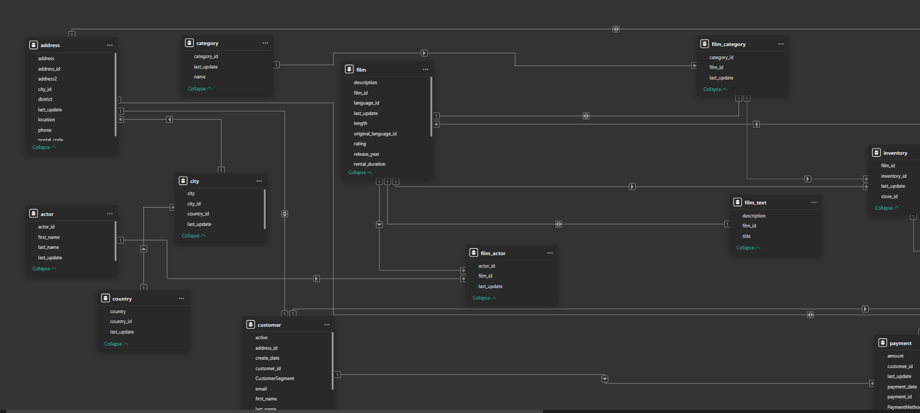

Slide 7
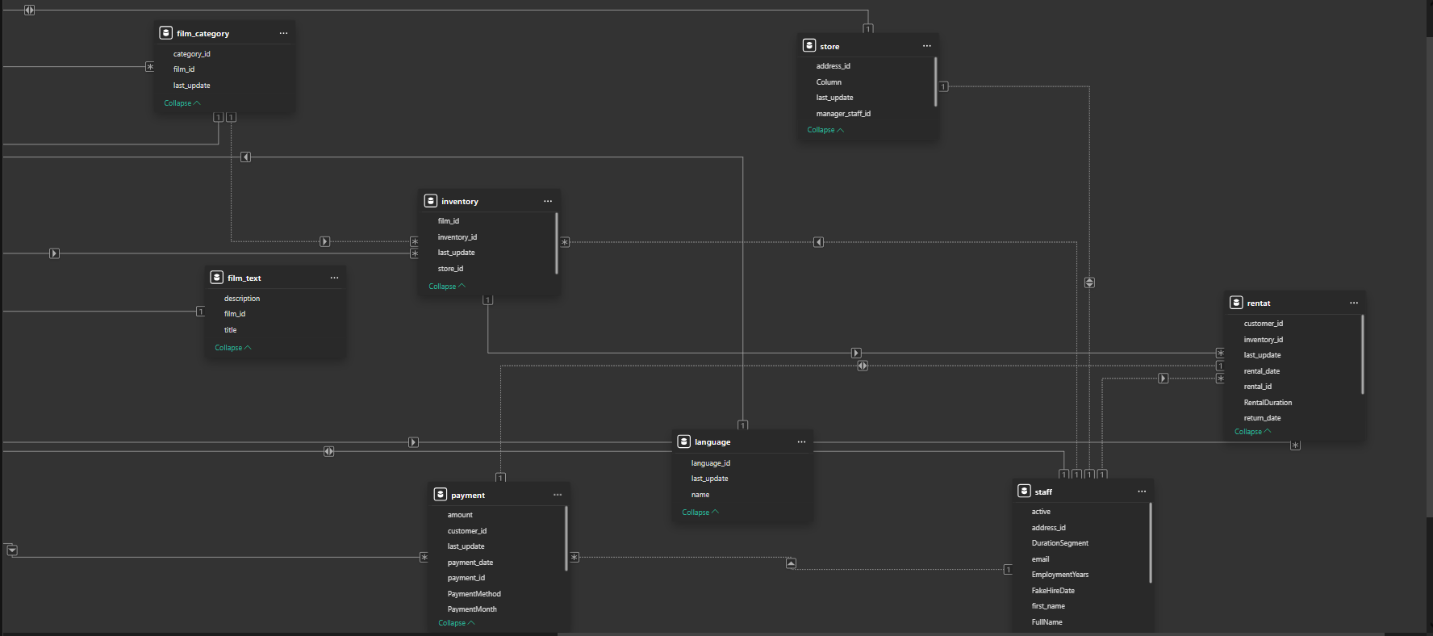

Slide 8
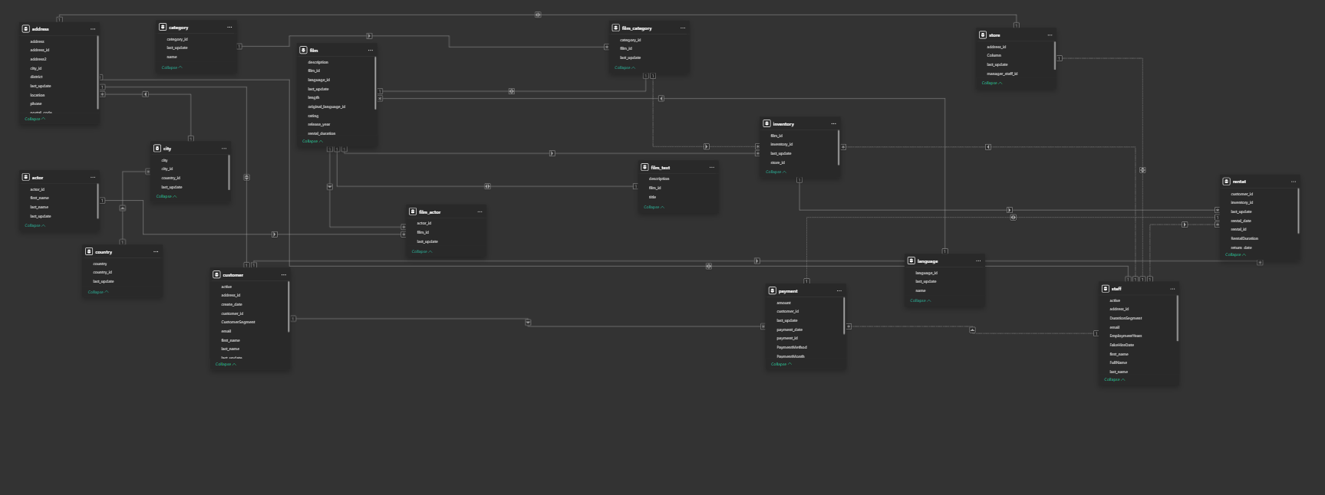

Slide 9
Power BI Problem Statements

Slide 10
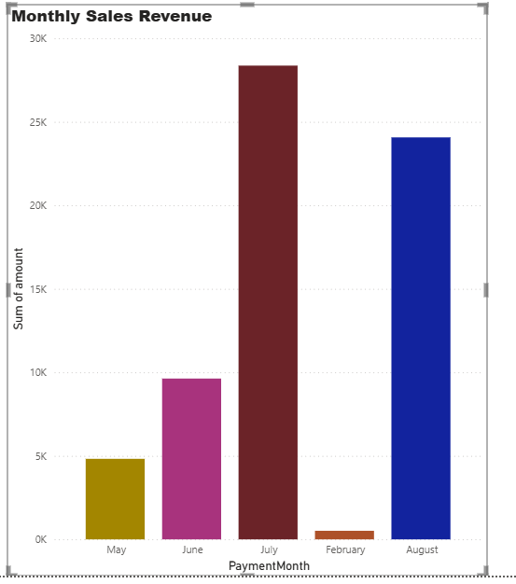
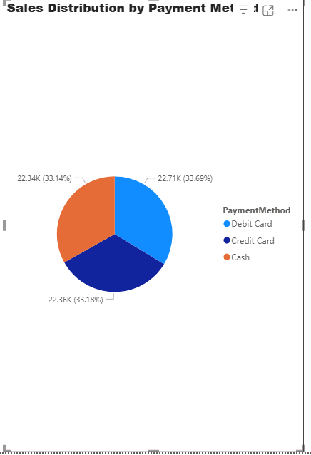
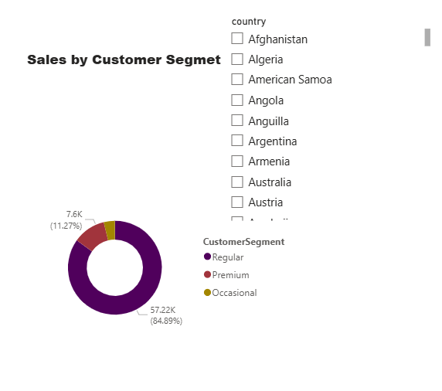
Revenue & Sales Analysis:

Slide 11
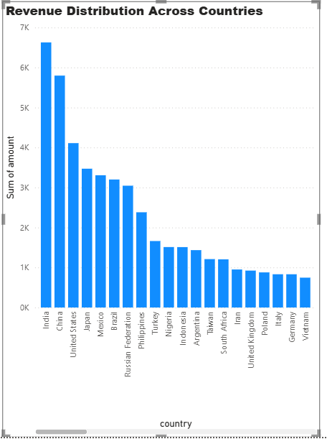
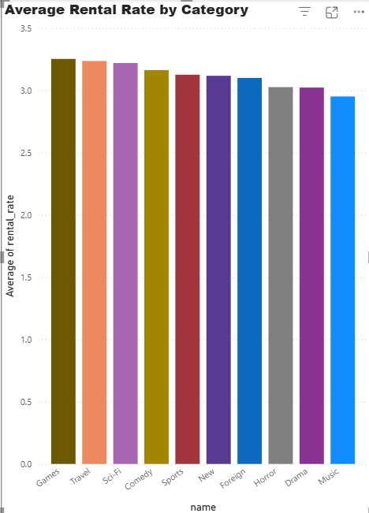

Slide 12
How does the sales revenue vary by month?
Sales revenue fluctuates across months, with clear seasonal peaks. Higher revenues are observed during holiday periods, suggesting increased rental demand. This trend helps in planning future promotional campaigns and inventory stocking.

Slide 13
What is the distribution of sales by payment method?
Credit card payments dominate the transactions, followed by cash and store credit. The low adoption of certain methods indicates an opportunity to introduce or promote alternative payment options like digital wallets.

Slide 14
Which customer segments generate the highest sales?
The "Regular" and "Premium" customer segments generate the highest sales. These segments also show high rental frequency, indicating strong engagement and the potential for loyalty programs.

Slide 15
How does the rental revenue vary by country?
Countries like the USA and Canada lead in revenue generation. Regional differences in pricing, customer base, or film availability may influence this variation.

Slide 16
Which film categories have the highest rental rates?
Categories like Action, Animation, and Horror have higher average rental rates. These premium rates align with customer demand and content popularity.

Slide 17
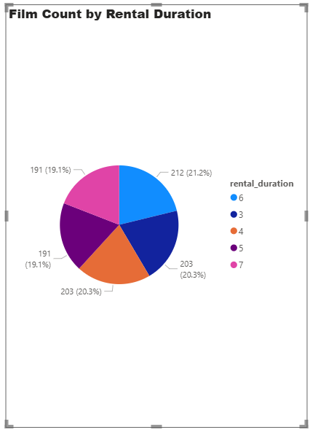
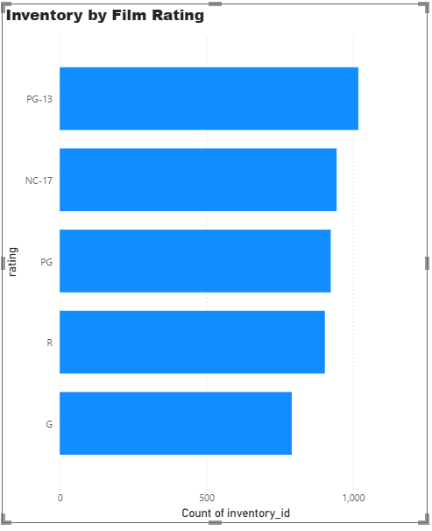
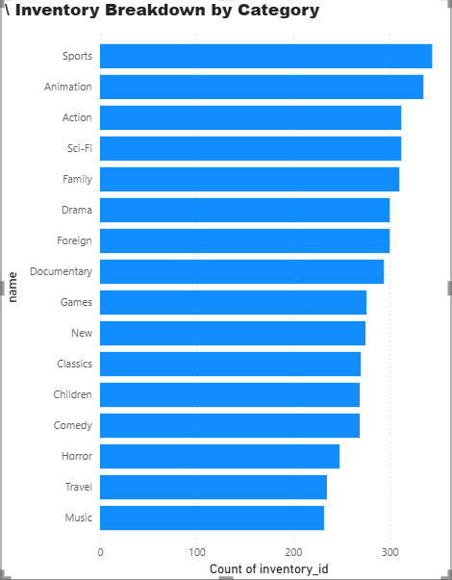
Inventory & Film Analysis

Slide 18
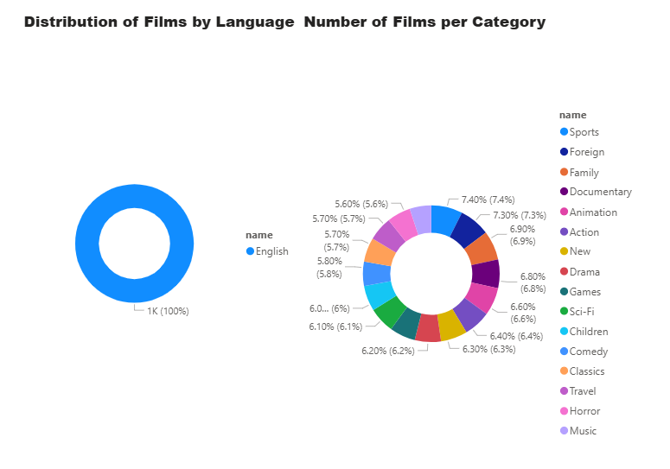
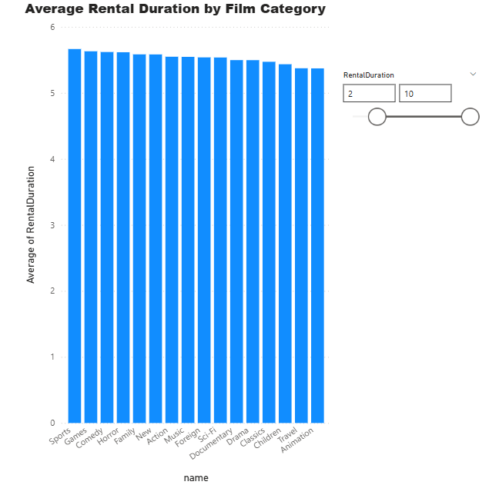

Slide 19
What is the distribution of films by rental duration?
Most films fall under 3–5day rental periods, which aligns with customer convenience and standard rental policies. Fewer films have shorter or longer durations, suggesting room to diversify rental options.

Slide 20
How does the inventory vary by film rating?
Films rated "PG-13" and "R" dominate the inventory. There are fewer "G" and "NC-17" rated films, indicating either limited supply or lower demand. This insight can guide inventory planning based on target audiences.

Slide 21
What is the breakdown of film categories in the inventory?
Categories such as Action, Comedy, and Sci-Fi have the highest number of films in stock. Underrepresented genres like Documentary and Music may offer niche marketing opportunities.

Slide 22
What is the distribution of films by language?
English-language films dominate the catalog, with a few Spanish, French, and German titles. This reflects the customer base but also highlights an opportunity to expand multilingual offerings.

Slide 23
How does the average rental duration vary by film category?
Some categories such as Documentaries and Drama tend to have longer rental durations. Others like Action and Comedy show shorter durations, possibly due to binge-watching or shorter runtime.

Slide 24
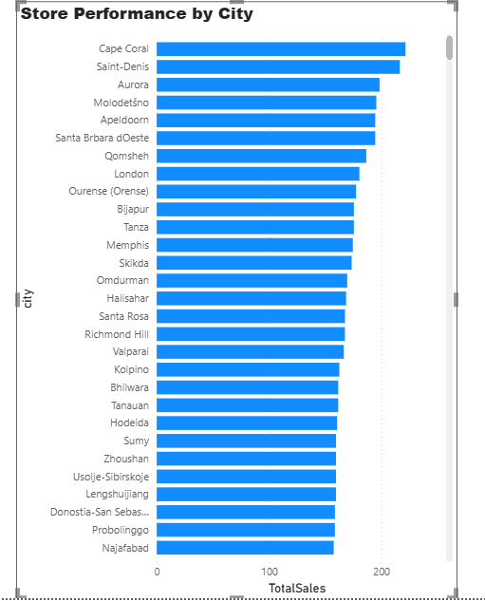
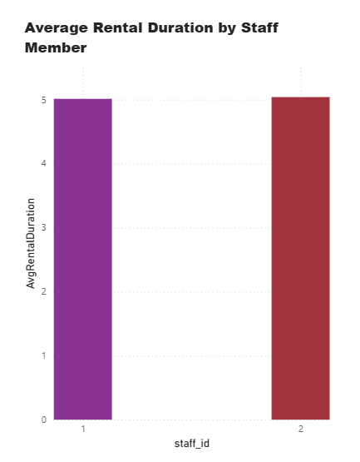
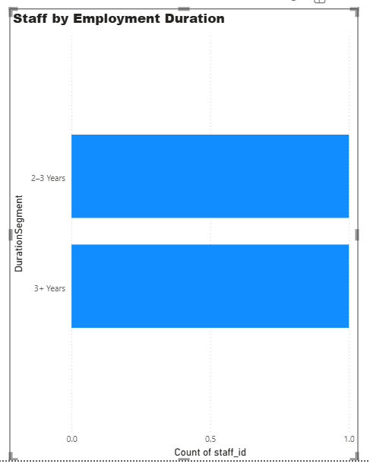
Staff & Store Performance

Slide 25
What is the distribution of staff by employment duration?
Most staff have been with the company for 2–4 years, suggesting moderate retention. A few long-serving employees highlight experience depth, while newer hires indicate recent scaling or turnover.

Slide 26
How does the store performance vary by location?
One store consistently outperforms the other in terms of rentals and revenue. Factors like customer volume, staff efficiency, or regional demand may contribute to the gap, suggesting best practices can be shared across locations.

Slide 27
What is the average rental duration by staff member?
Rental duration varies slightly between staff members, with some handling quicker turnarounds. This may point to differences in customer interaction or service efficiency.

Slide 28
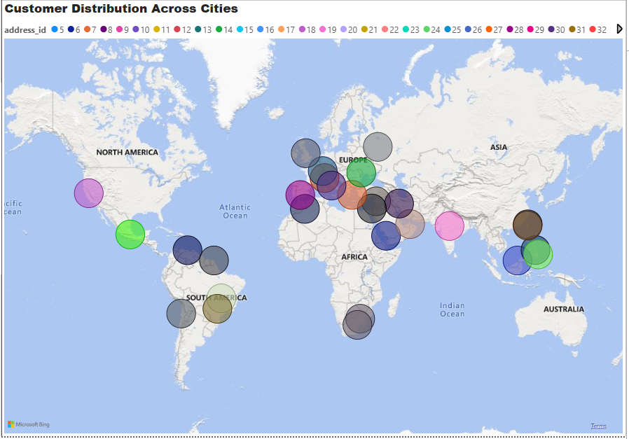
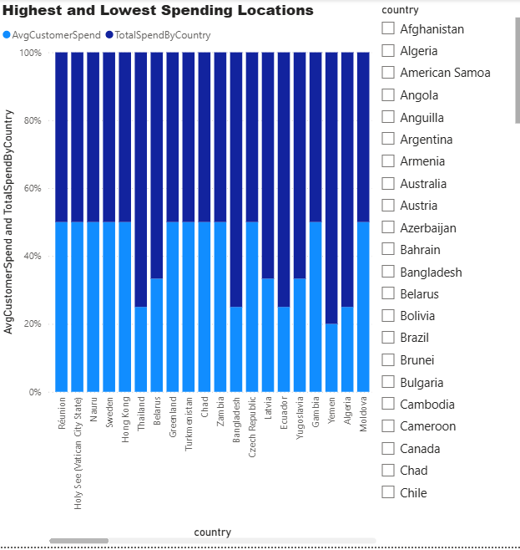
Customer & Location Analysis

Slide 29
What is the distribution of customers across different cities?
Customers are concentrated in a few major cities, such as New York, Los Angeles, and Chicago. Smaller cities show lower customer counts, helping identify potential regions for growth or local marketing.

Slide 30
Which locations have the highest and lowest customer ratings?
Some cities consistently receive higher customer ratings, suggesting better service or store experience. Lower-rated areas may benefit from improved customer support or process changes.

Slide 31
Insights & Recommendations:
Peak sales occur during specific months, pointing to seasonal demand trends.
Credit cards and in-store payments dominate, suggesting limited use of digital wallets.
Action, Comedy, and Sci-Fi films attract the most rentals and revenue.
Films with shorter rental durations are rented more frequently.
Store performance varies significantly by location; targeted campaigns are needed in underperforming areas.
Some staff members handle disproportionately high rental durations, which can help identify top performers.
Customer satisfaction varies widely across countries — suggesting service quality optimization opportunities.

